Slide 1

6G Vision
Presented by
Bharathwaj.M

Slide 2

What is 6G?
6G is the successor to 5G cellular technology -- 6G networks will be able to use higher frequencies than 5G networks and provide substantially higher capacity and much lower latency. One of the goals of the 6G Internet will be to support one micro-second latency communications.
The 6G technology market is expected to facilitate large improvements in the areas of imaging, presence technology and location awareness. Working in conjunction with artificial intelligence (AI), the computational infrastructure of 6G will be able to autonomously determine the best location for computing to occur.

Slide 3
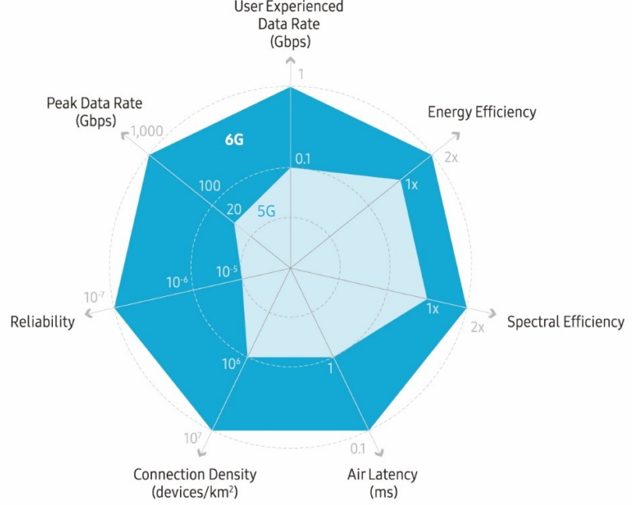
Advantages of 6G over 5G
6G is expected to support data rates of 1 terabyte per second (Tbps). This level of capacity and latency will be unprecedented and will extend the performance of 5G applications along with expanding the scope of capabilities in support of increasingly new and innovative applications across the realms of wireless connectivity, cognition, sensing and imaging,holograms,improved robot surgery from a long distance

Slide 4
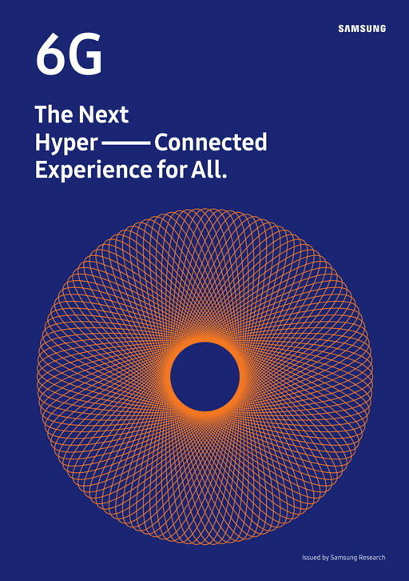
Why are people talking about 6G already?
Samsung is already outlining its plans. Samsung has started to publicize its direction for 6G, the next generation of wireless networks likely to supersede 5G sometime in the next decade. The company joins Nokia and a few other organizations that are exploring the upgrade.
On July 14, Samsung released a white paper entitled “The Next Hyper-Connected Experience for All.” outlining the company’s vision for the next generation communication system, namely 6G.
Samsung says “6G features will include better spectral and energy efficiency and a requirement for trustworthiness that, “addresses the security and privacy issues arising from the widespread use of user data and AI technologies. This sparks a interest to tech gurus and others.

Slide 5
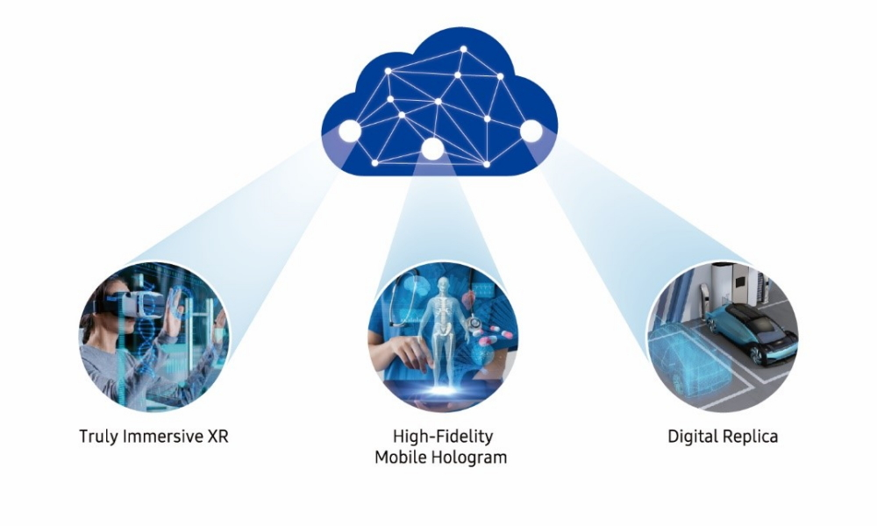
When can we expect?
Samsung expects that the completion of the 6G standard and its earliest commercialization date could be as early as 2028, while mass commercialization may occur around 2030. Both humans and machines will be the main users of 6G, and 6G will be characterized by provision of advanced services such as truly immersive extended reality (XR), high-fidelity mobile hologram and digital replica.

